Slide 1
The Collectors’ Cosmos:
The Meakins-McClaran Print Collection
16 July – 14 November 2021 — National Gallery of Canada, Ottawa
A Preview of the Exhibition
Presented by
Dr. Jonathan Meakins
&
Erika Dolphin
Interim Senior Curator of Prints & Drawings, NGC
Notes:
233 works and 159 frames

Slide 2
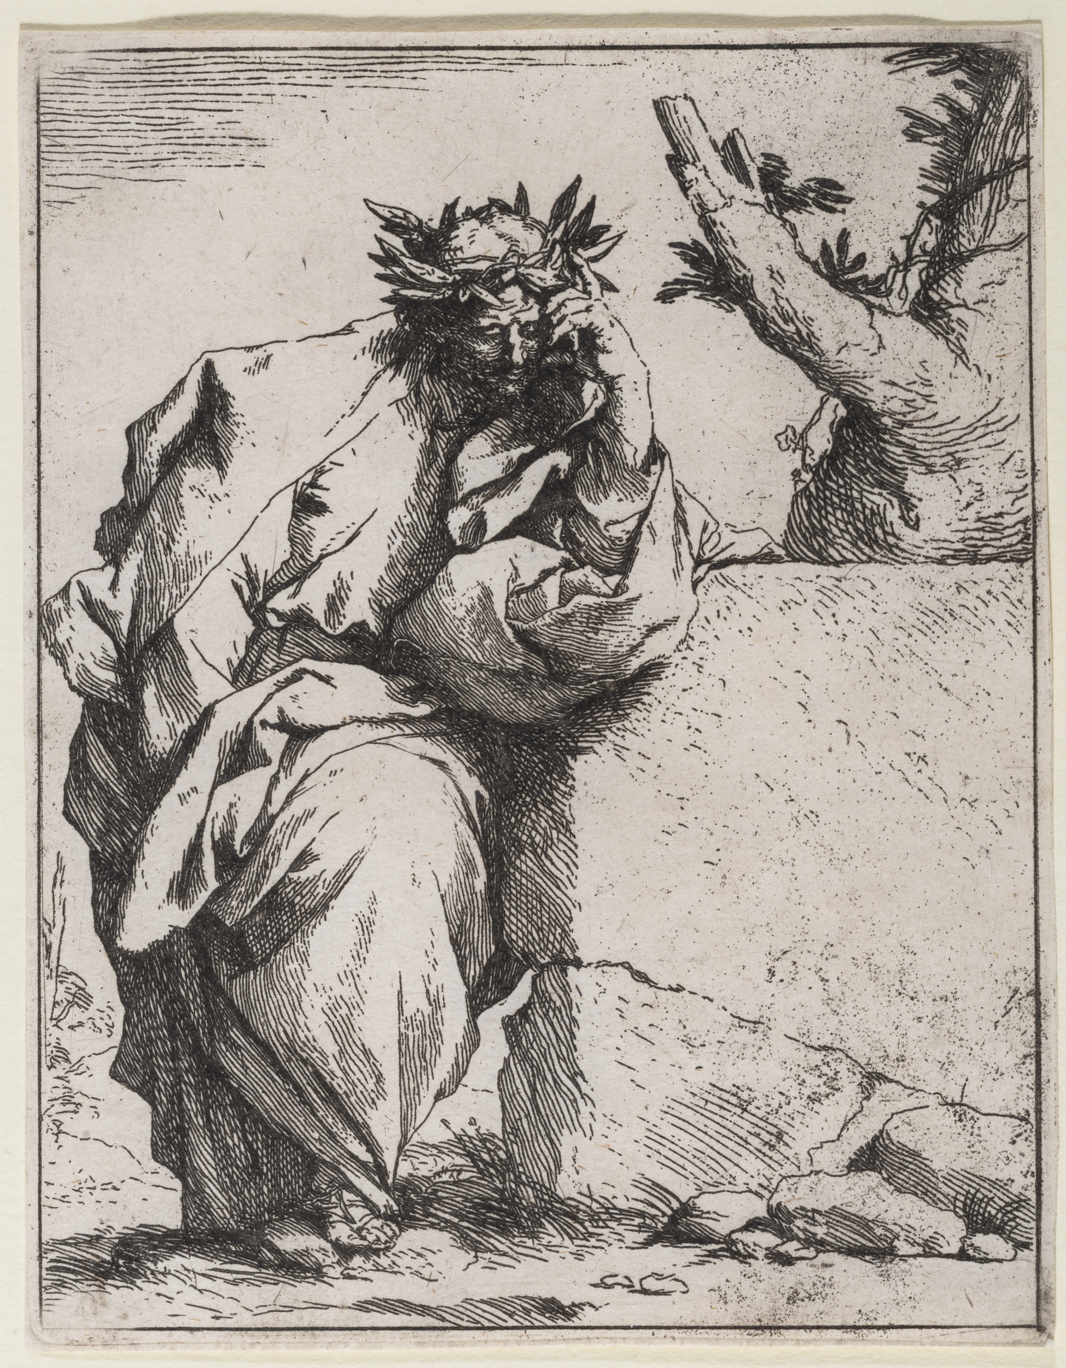
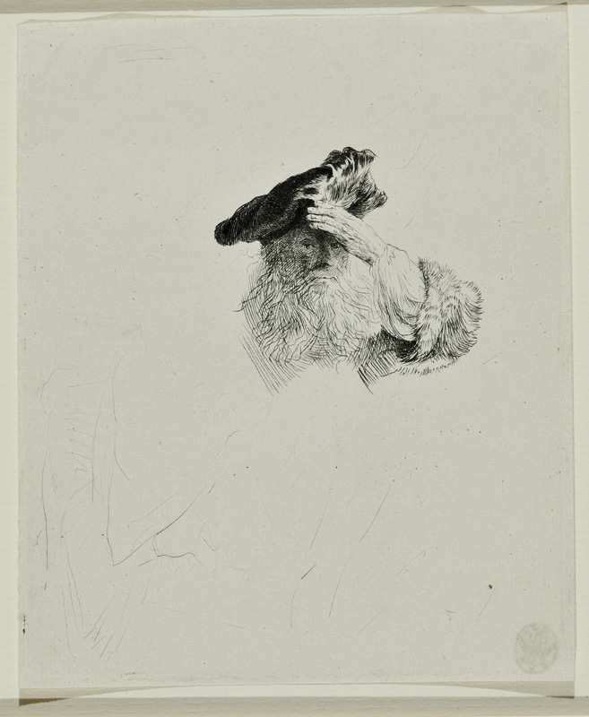
Jusepe de Ribera
The Poet c. 1620–21
etching
Rembrandt van Rijn
Old Man Shading His Eyes with His Hand c. 1639
etching and drypoint
Notes:
Ribera 328 – Jusepe Ribera, The Poet, c. 1621 [18-F2]
Rembrandt 323 – Rembrandt, Old Man Shading his Eyes with his Hand, 1639 [10-F2]

